Slide 1

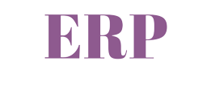
Presented By: Team (A)
Ye Zaw Oo
May Phyo Thu
18.11.2022

Slide 2
Presentation Outline
Enterprise Resource Planning
On-Demand Open Object
Odoo Sales Module

Slide 3
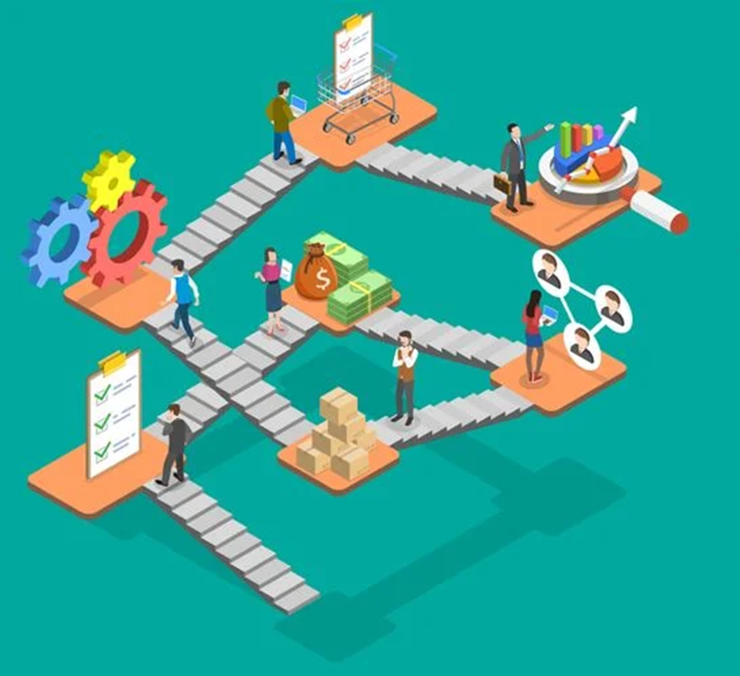
What is ERP ?
Enterprise Resource Planning
‌A system organizations use to manage and integrate the essential parts of their businesses.
Figure: Example of ERP System

Slide 4

Characteristics of ERP Applications
Enterprise-wide integration
Real-time (or near real-time) operations
Central Common Database
Figure: ERP System

Slide 5
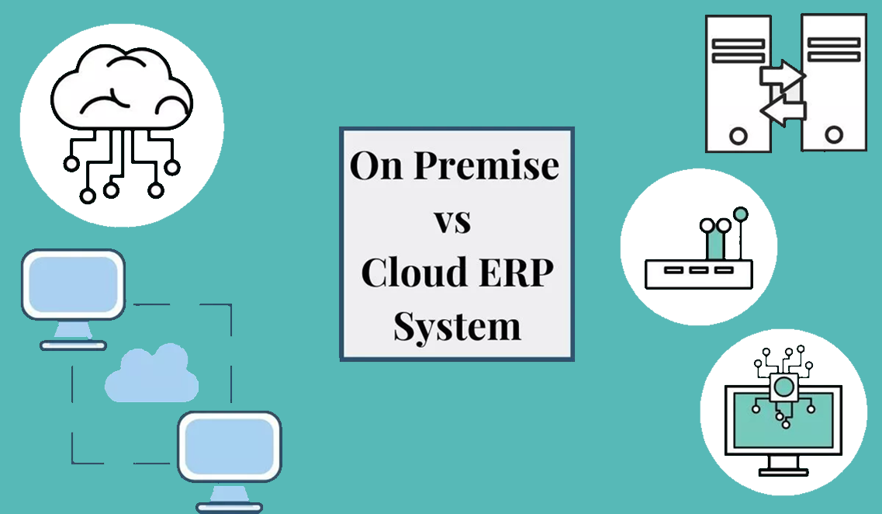
Types of ERP
Figure: Types of ERP System

Slide 6
Benefits of ERP
Reduce manual and repetitive tasks
Minimize the chance of having human error
Increase productivity of employees
Centralized database to one platform
Standardized input of data allows for quick reporting
Easy communication between departments

Slide 7
Limitations of ERP
Expensive
High Implementation Times
Complex Data Conversion
Requires thorough training

Slide 8
What is Odoo ?
On-Demand Open Object
A large collection of business-related applications and modules like Sales, Accounting, Inventory, Purchase and more.

Slide 9
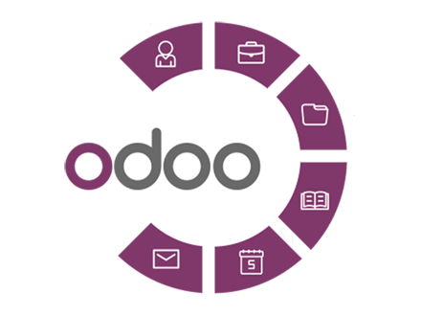
Known as Open ERP
Today, Odoo is one of the widely used open-source ERP solutions in the market.
Two Editions of Odoo:
Odoo Community (open-source)
Odoo Enterprise (licensed)

Slide 10
Why is Odoo becoming more and more popular ?
Open source
Highly Modular
Flexible
User Friendly
Up to date with Technology
Easily Integrates with Third-party Services
Industry-Specific Modules
Less Implementation Time Frame

Slide 11

Odoo Modules
Odoo is a modular architecture, for each need there is an application.
Odoo Modules are optional components built on top of the Odoo framework.
In these applications, there are tools such as CRM, Point of Sale management, sales management, inventory management, finance, marketing actions and more.
Odoo Modules are integrated: a module could share information stored in another module.

Slide 12

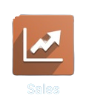
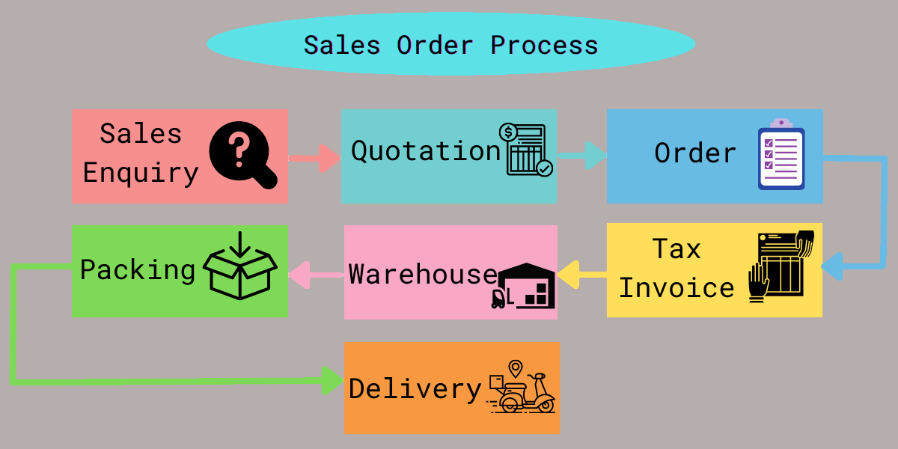
Odoo Sales Module is one of the star application that Odoo provides.
With Sales, we can control our Sales department on a single screen.
We can customize it according to our project requirements.

Slide 13
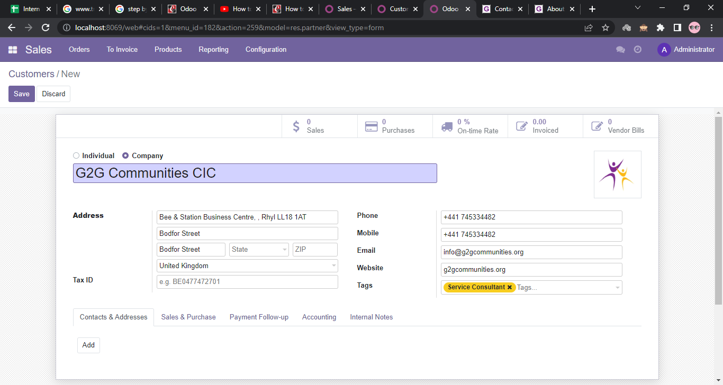
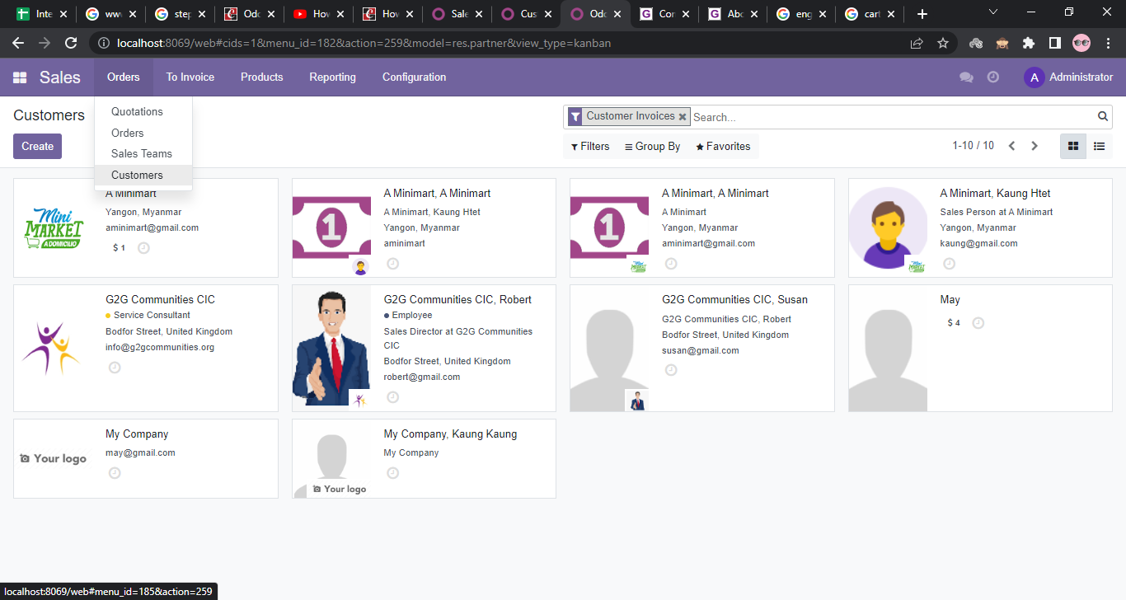
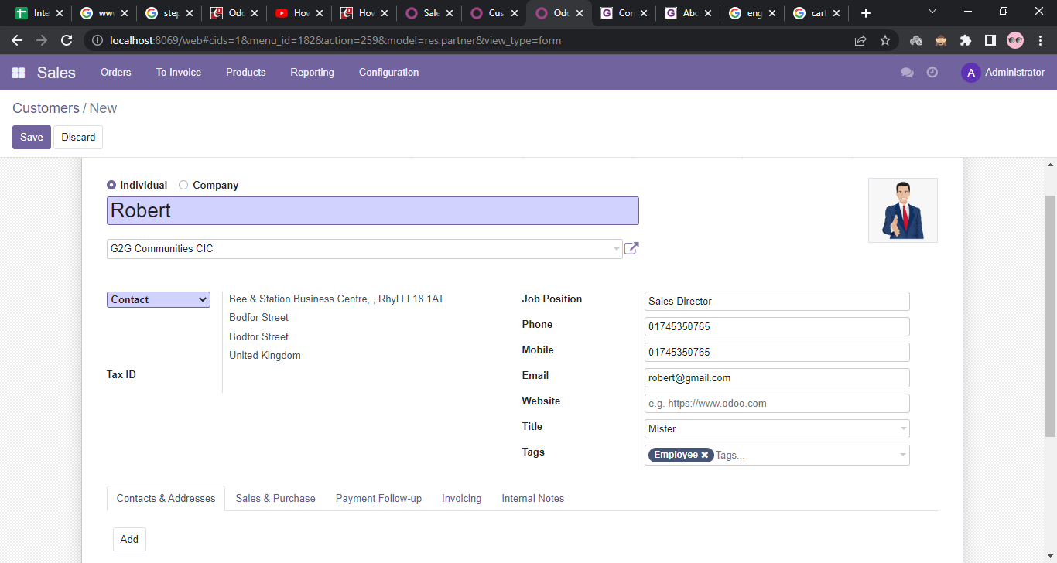
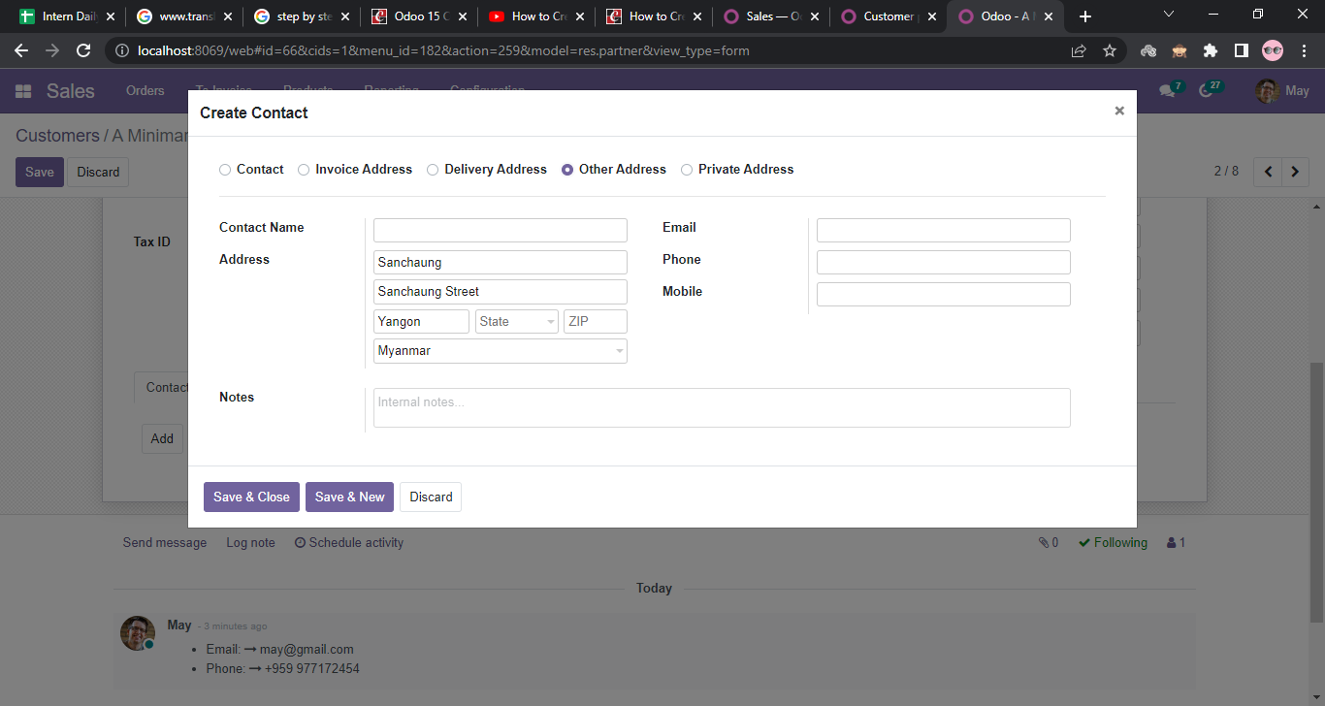
Creation of Customer
add multiple contacts inside a customer form

Slide 14
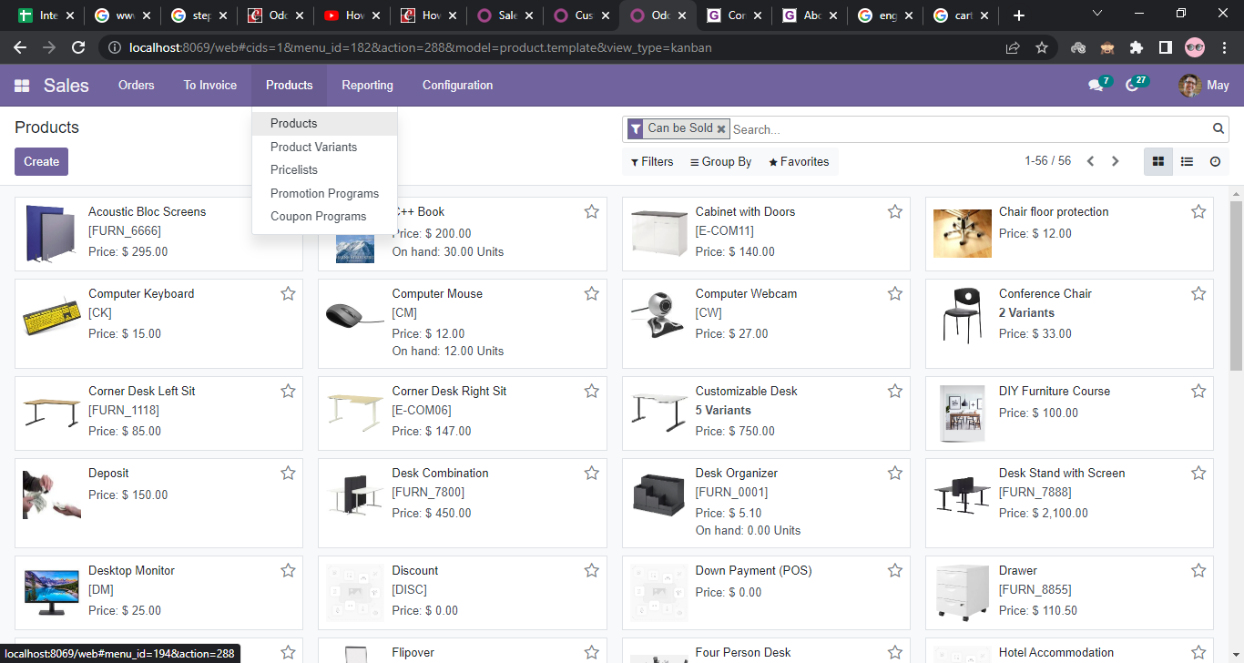
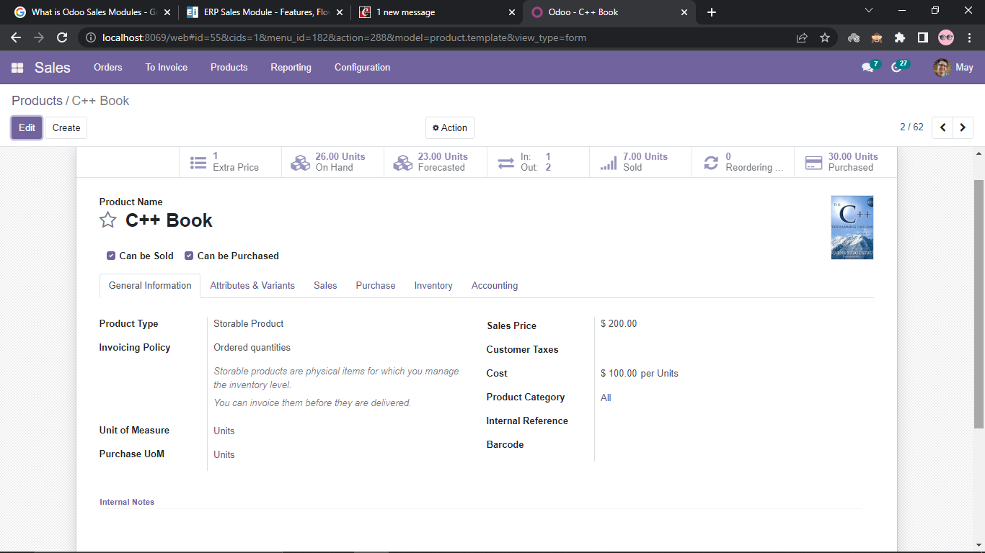
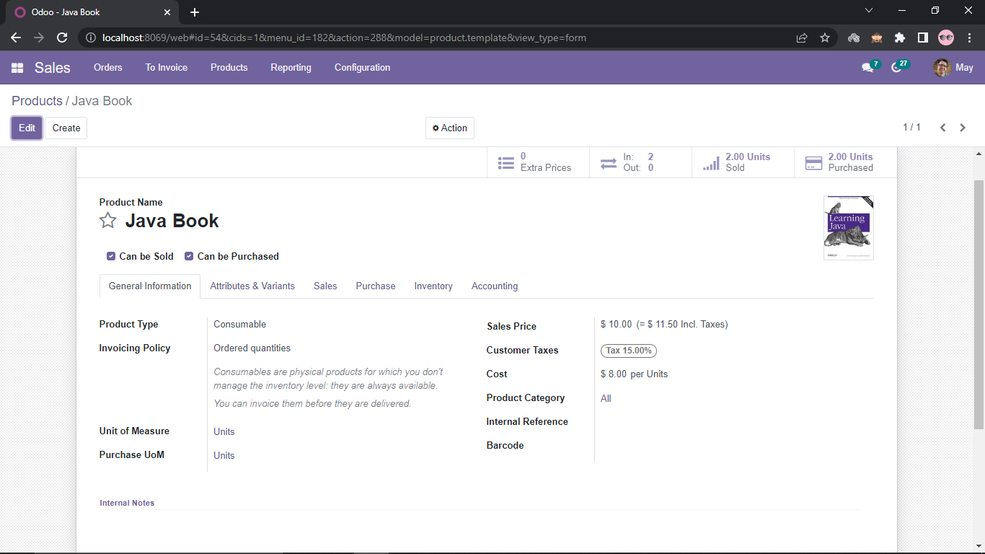
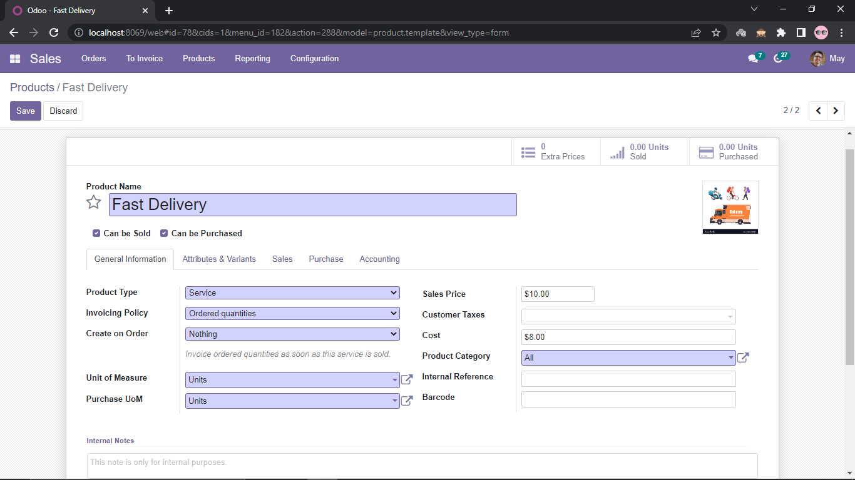
Creation of Product

Slide 15
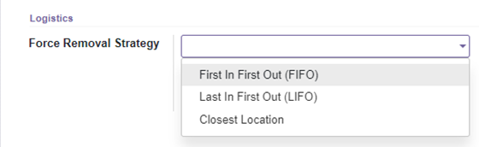
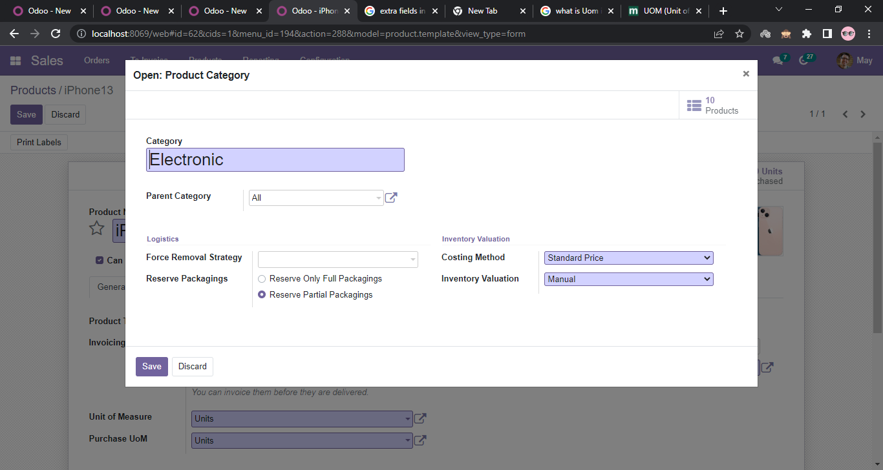
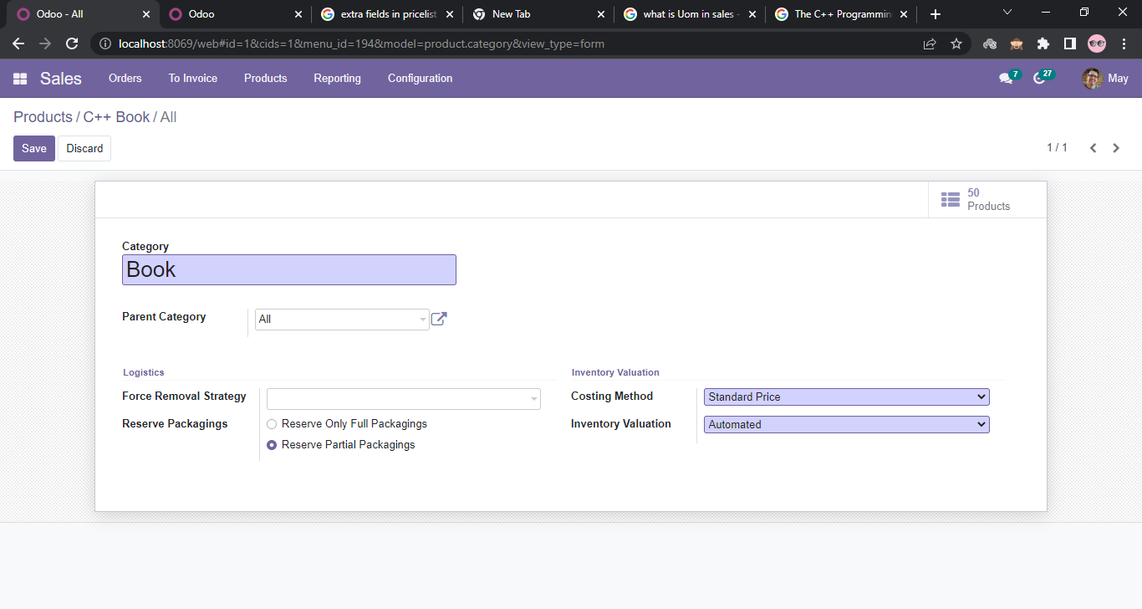
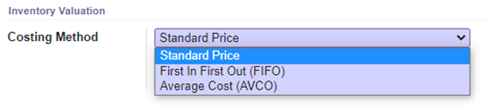
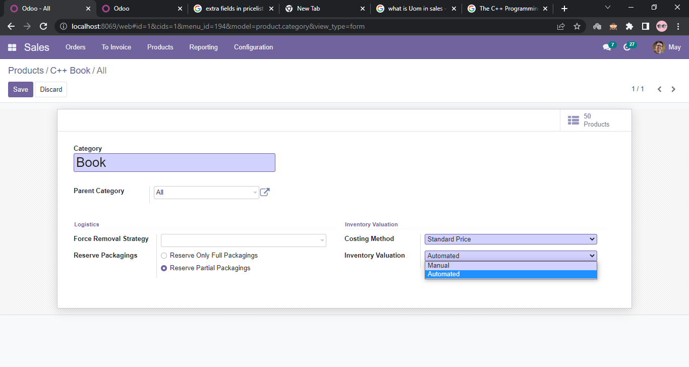
Configure Product Category
Choose Removal strategies to which product to be remove from inventory.
Select to reserve full as well as partial packages for this product categories.
Select Costing Method
The accounting entries to value the inventory are
not posted automatically or manual.

Slide 16
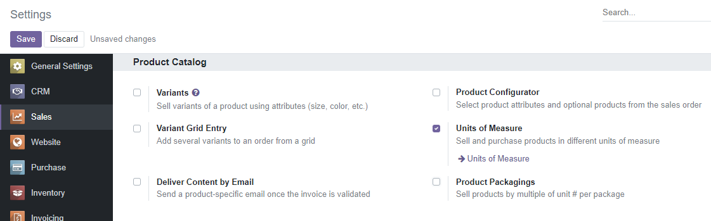
Unit of Measure
Configuration => Settings
UOM
Units
1 unit
Dozen
12 units
=

Slide 17
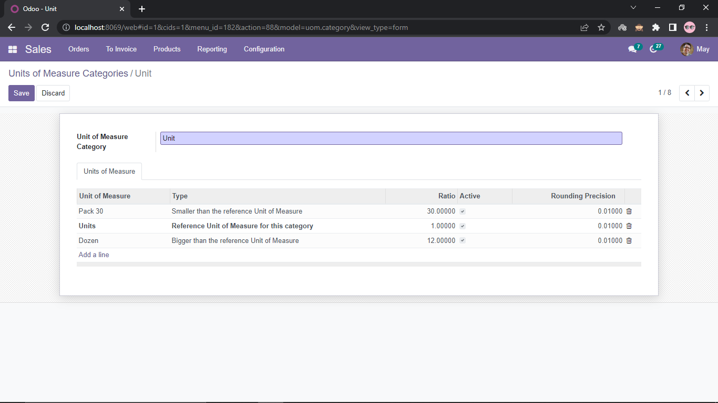
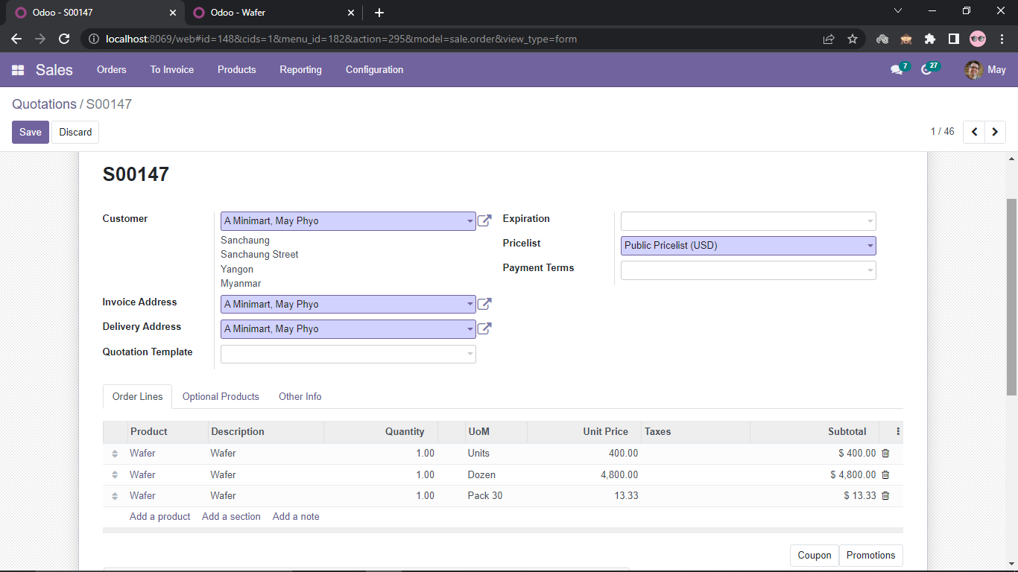
Configuration => Settings => Unit of Measure Categories
This product in sales order.

Slide 18
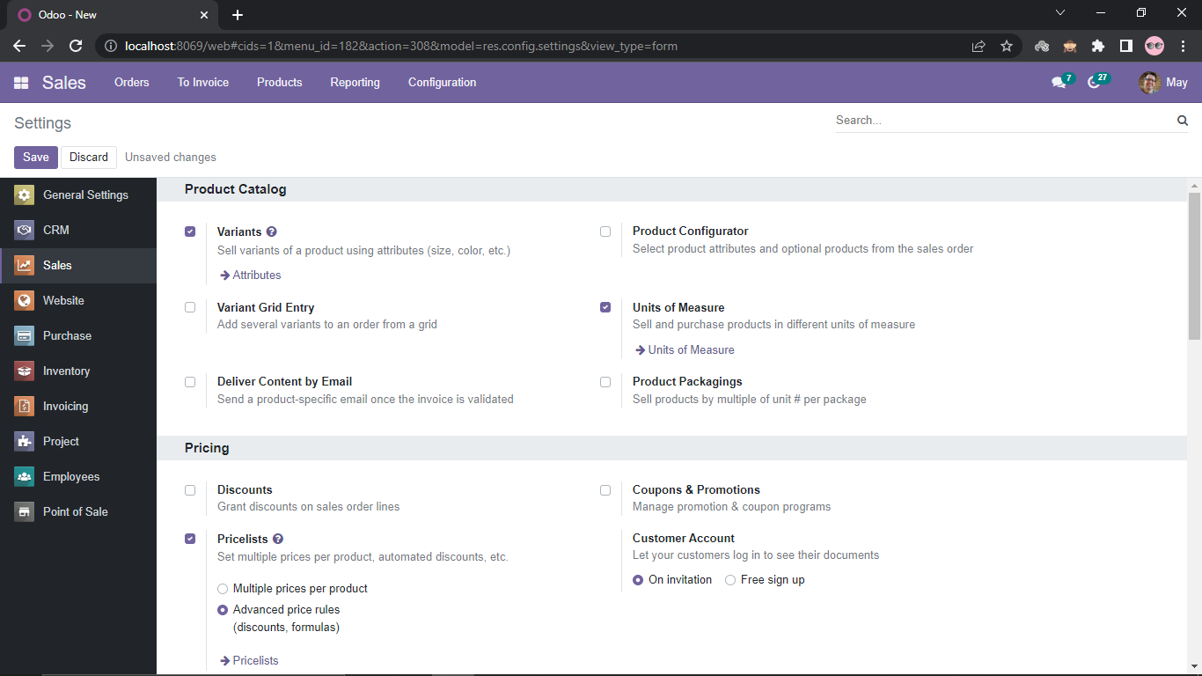
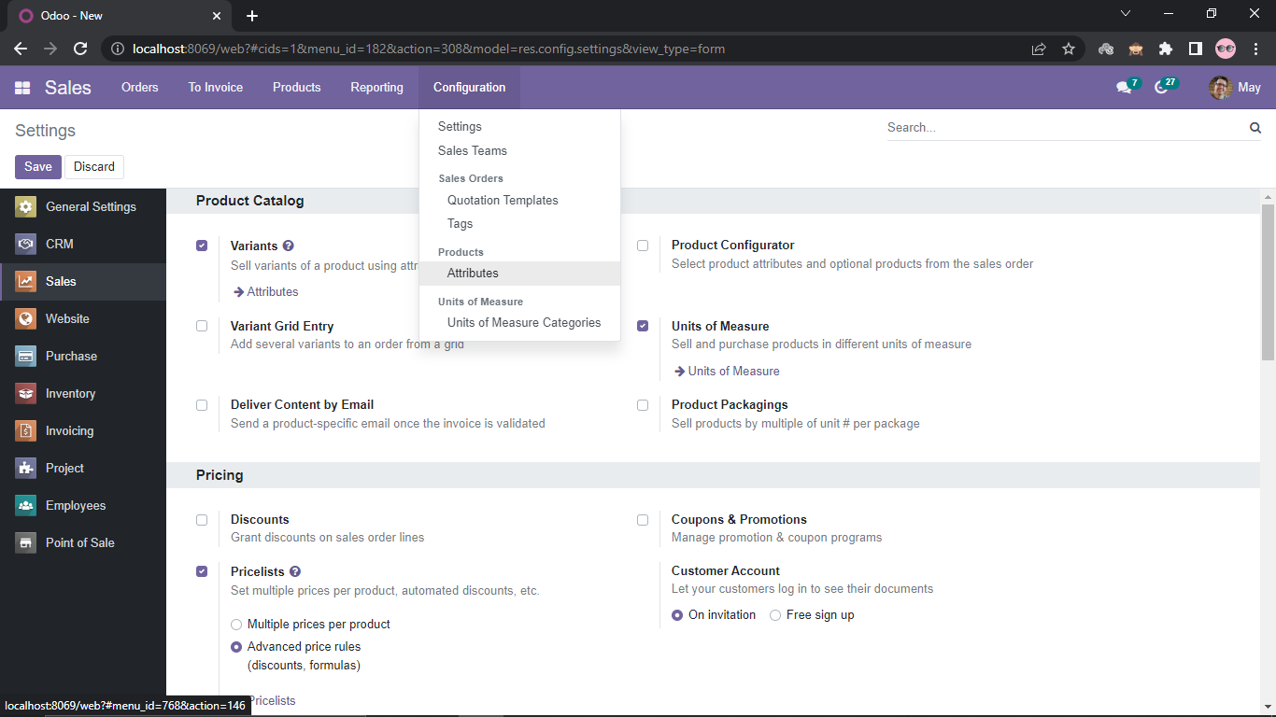
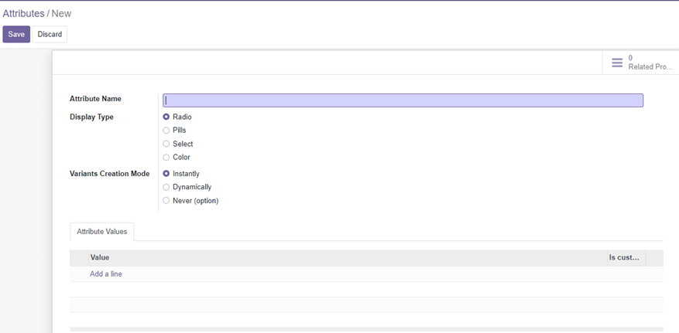
Product Variants Configuration
Configuration => Settings =>Variants
Configuration => Products =>Attributes

Slide 19
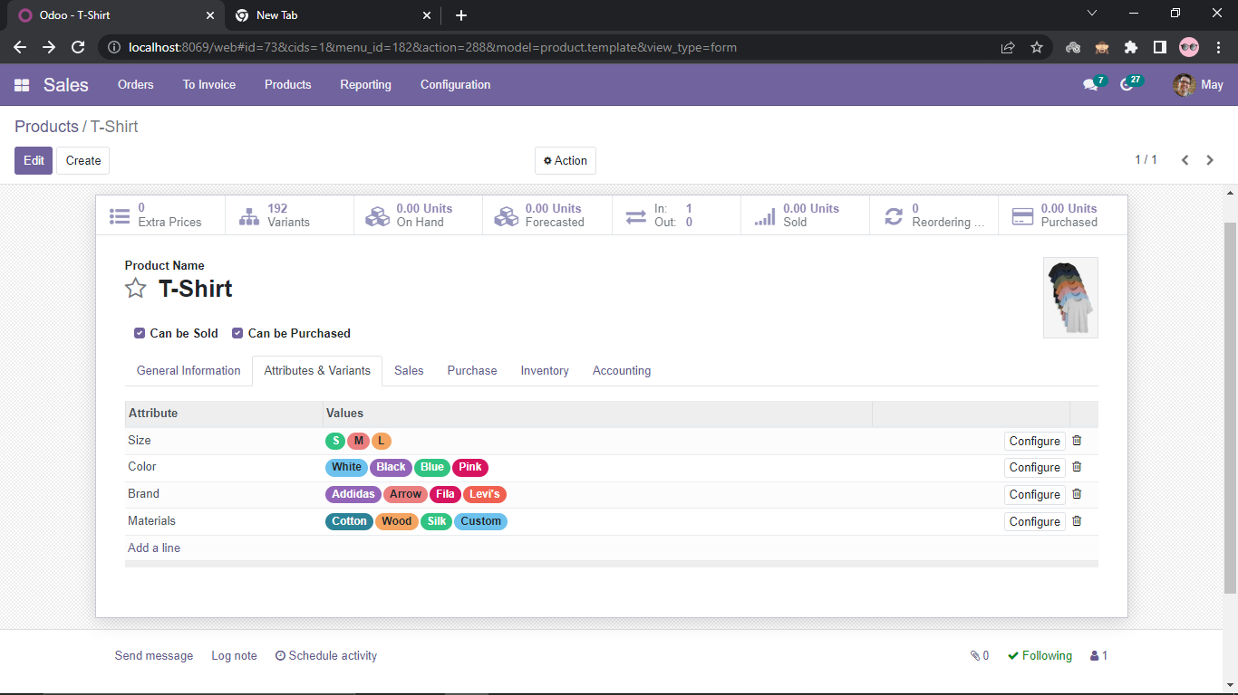
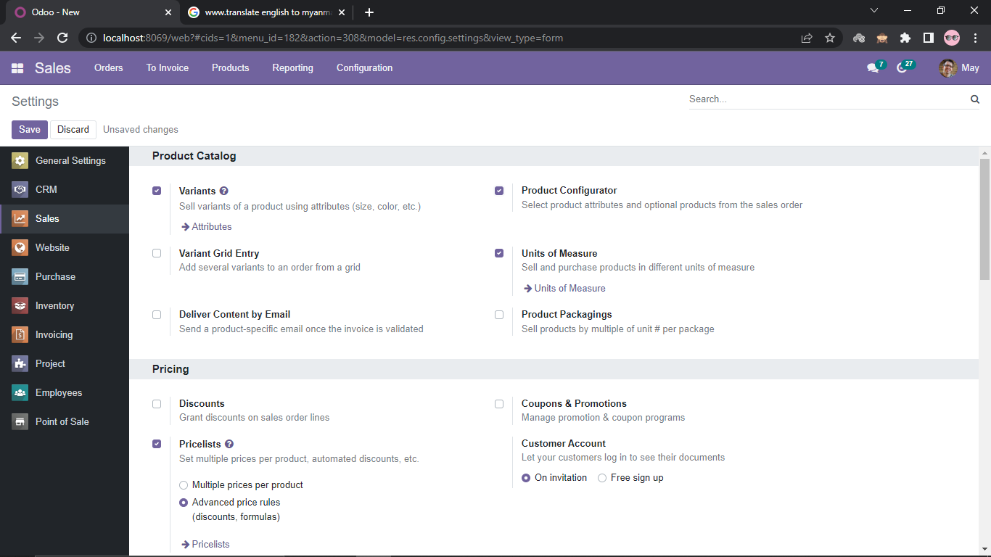
Variant custom mode is set instantly
(Instantly Variants Mode)

Slide 20
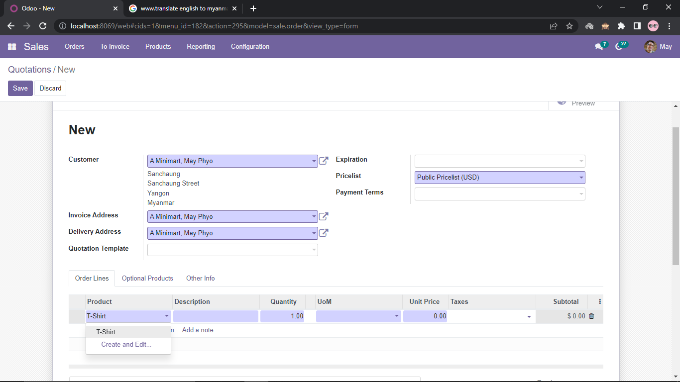
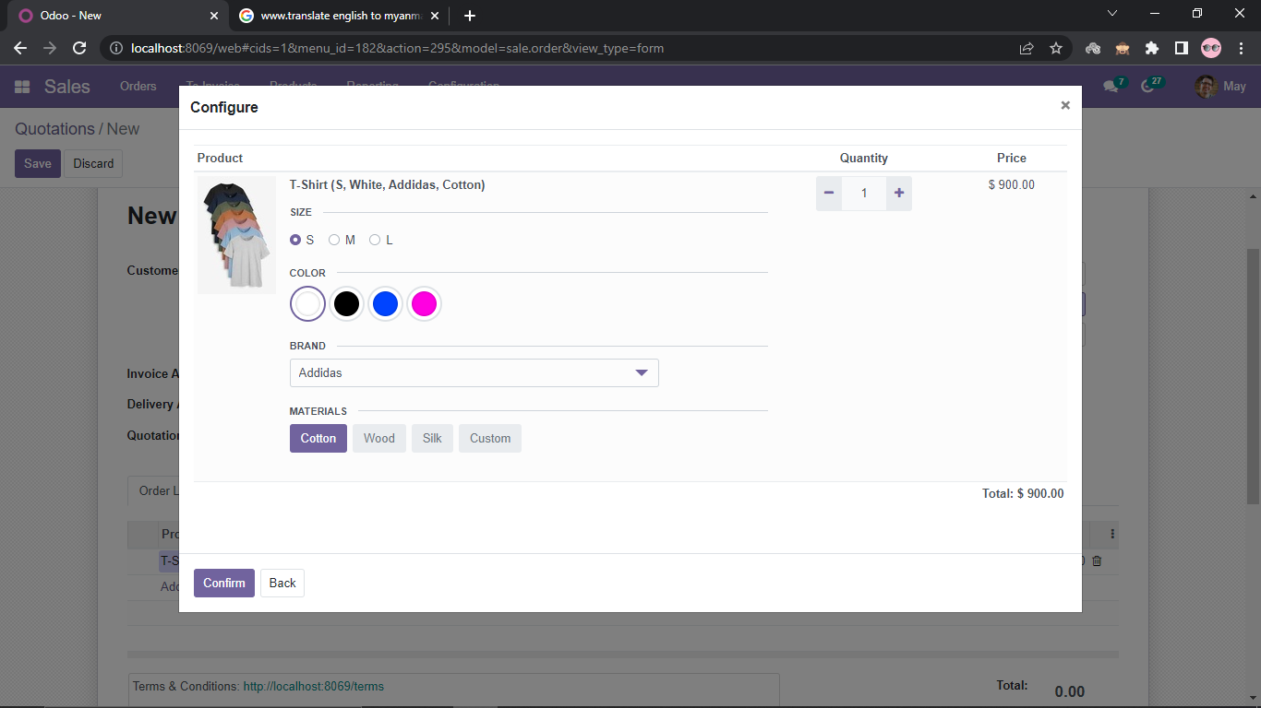
When this product demand in sales order, it is shown in figure.

Slide 21
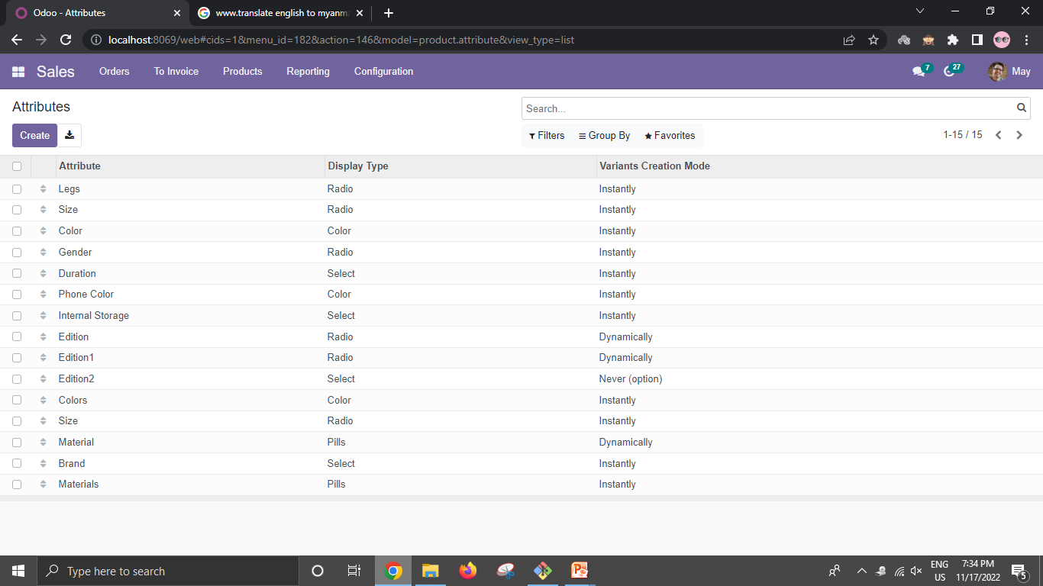
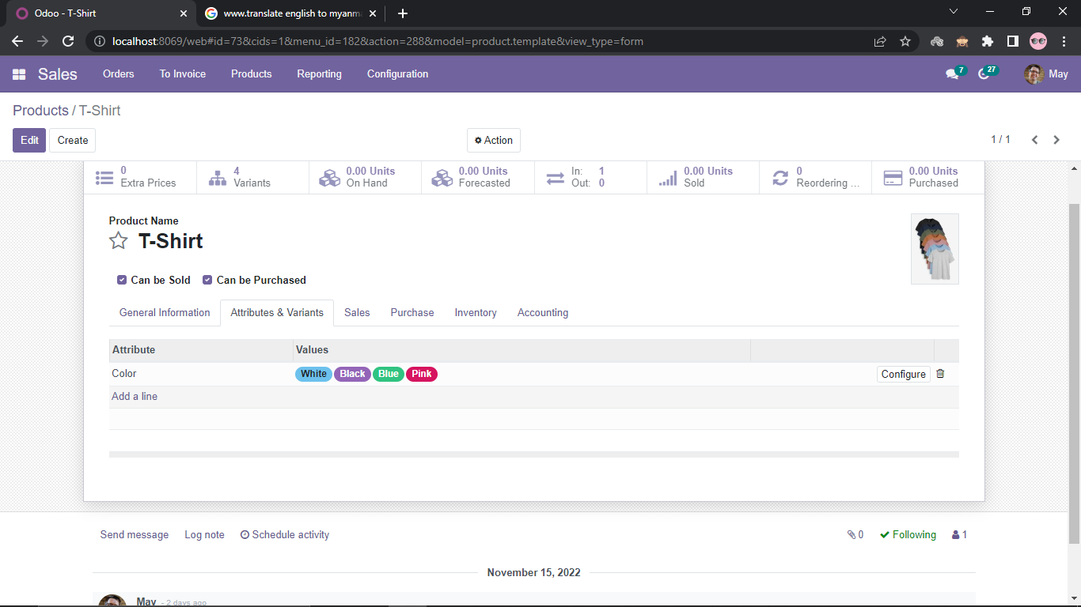
In another way by using Dynamic Variant Creation Mode
Product is set create with one attribute with instantly variant mode
instantly variant mode

Slide 22
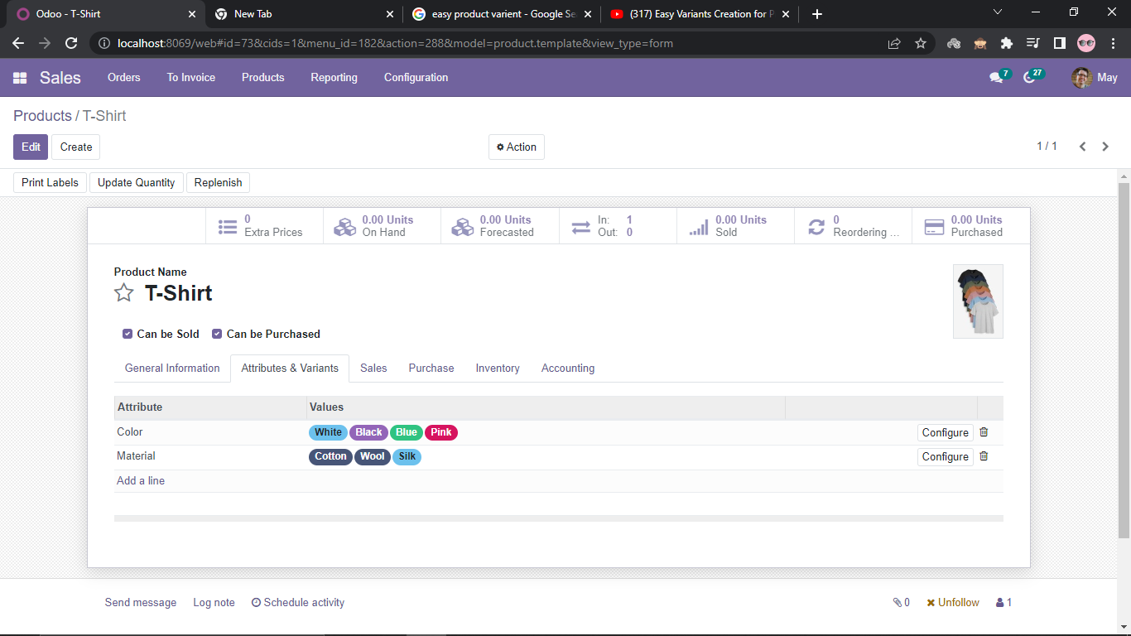
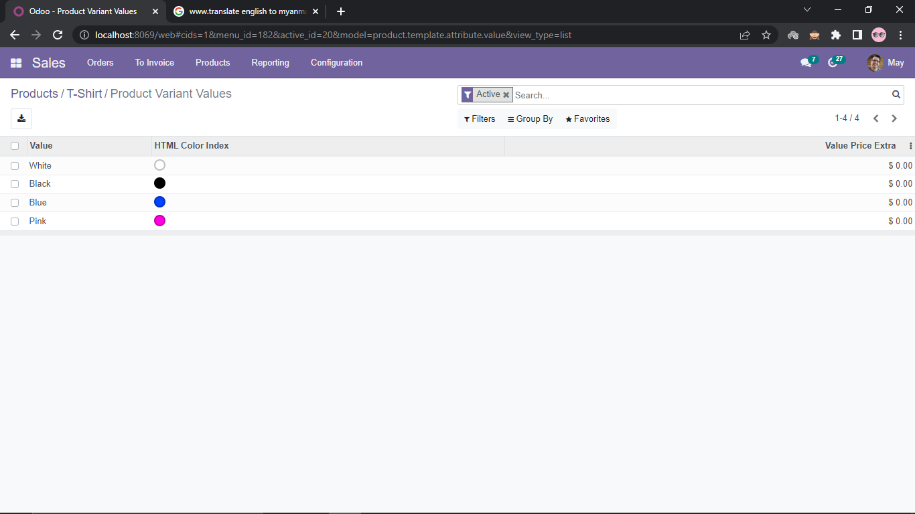
Add another attribute with dynamically variant mode.
dynamically variant mode

Slide 23
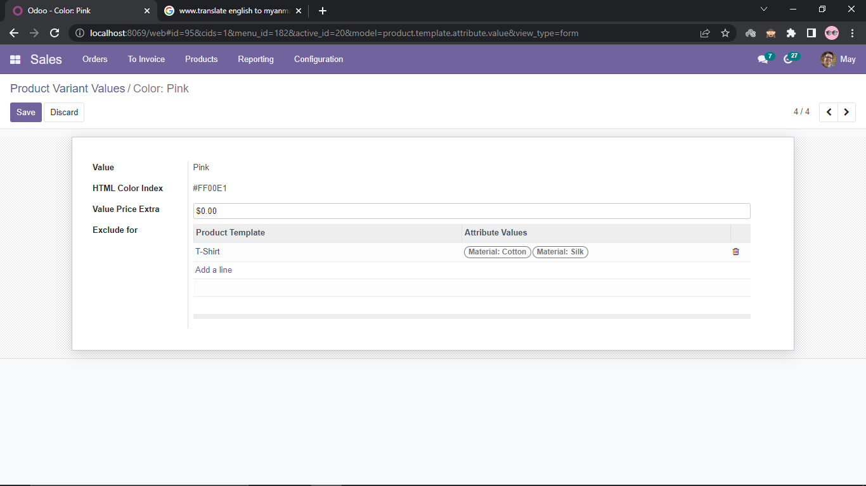
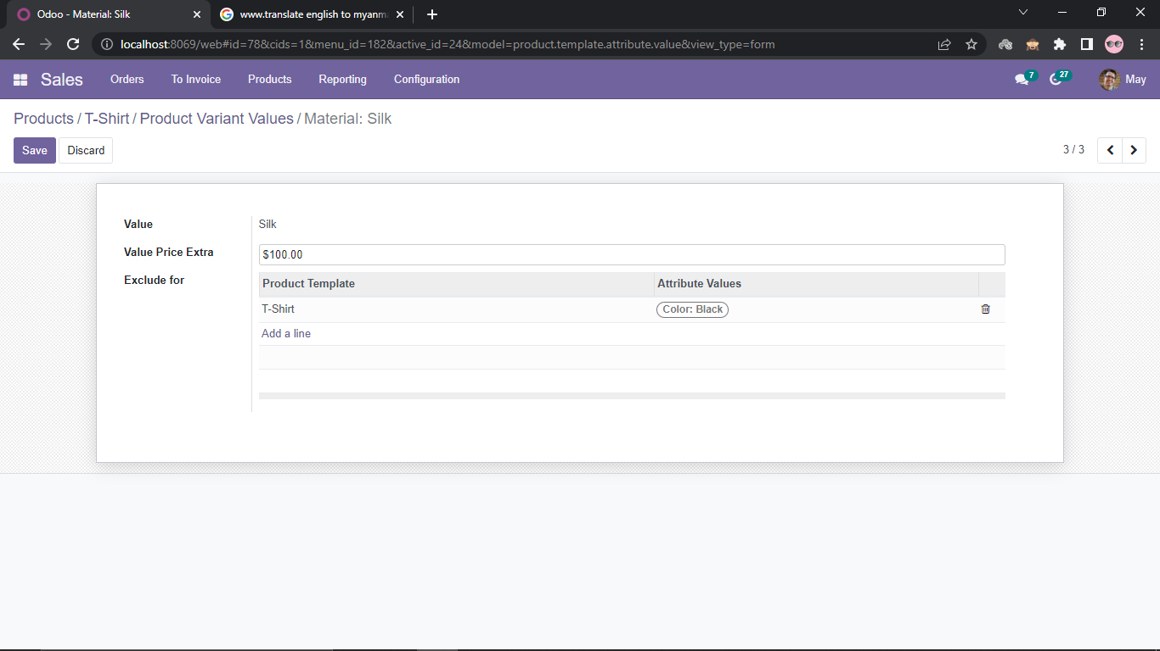
Configure Color =>T-Shirt(Pink , Cotton) and (Pink , Silk)is not available
Configure Material => T-Shirt(Silk , Black) is not available and add Extra Price is $100

Slide 24
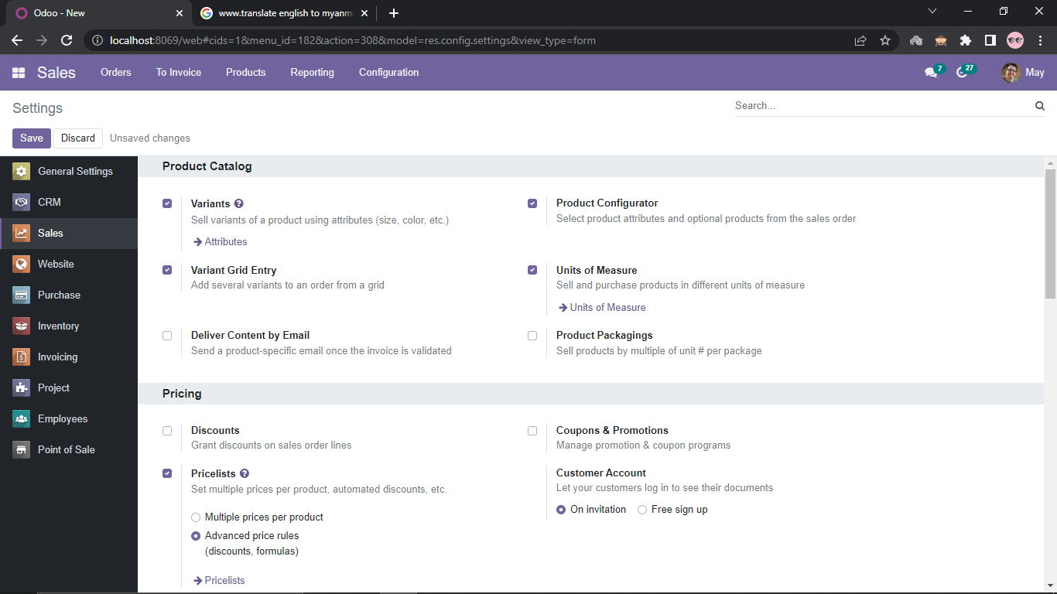
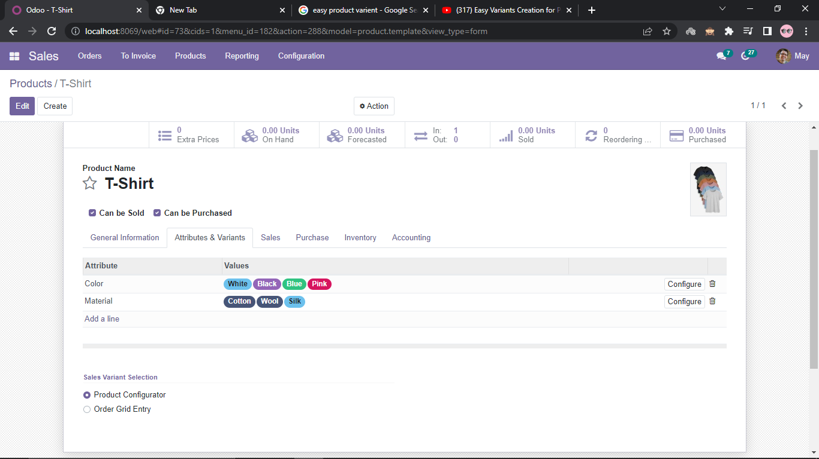
Configuration => Settings =>Variant Grid Entry
Product with product configurator.

Slide 25
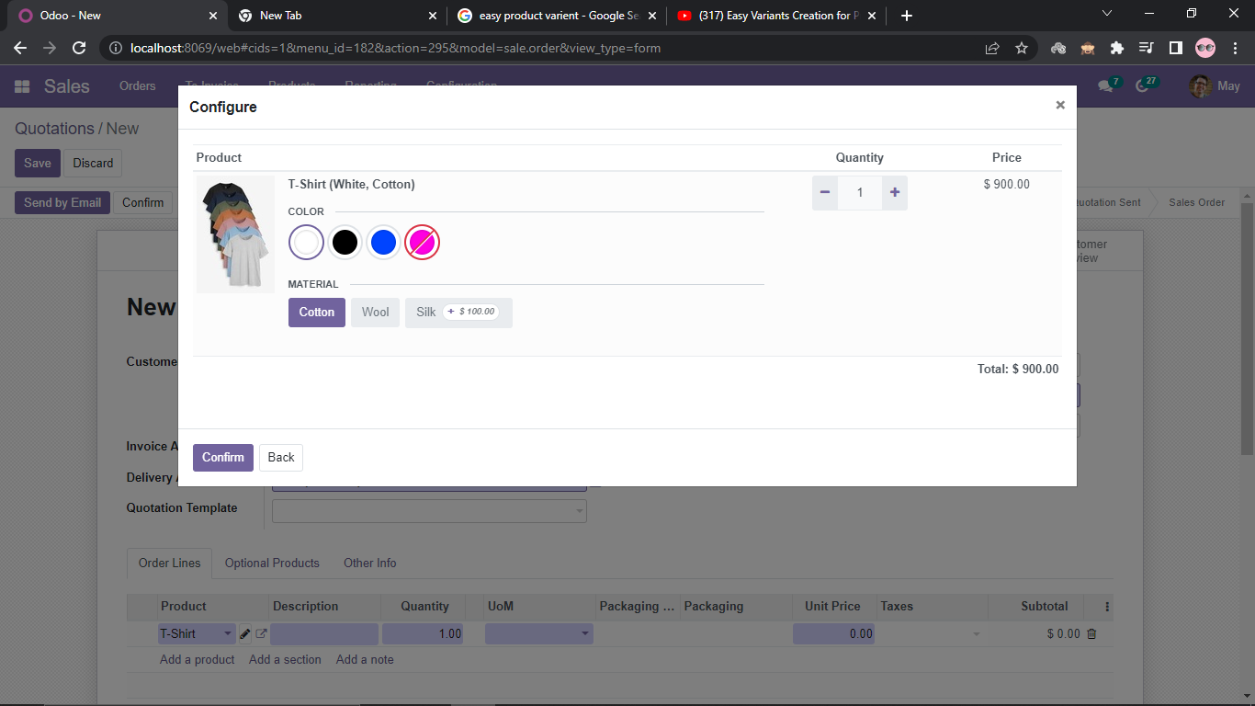
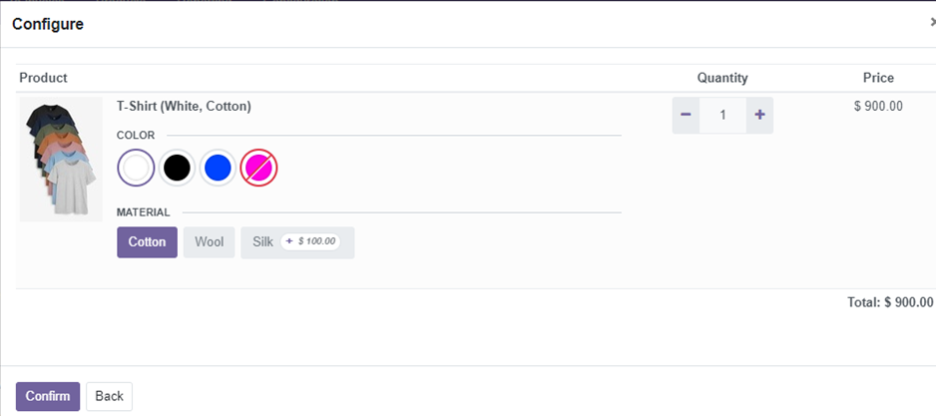
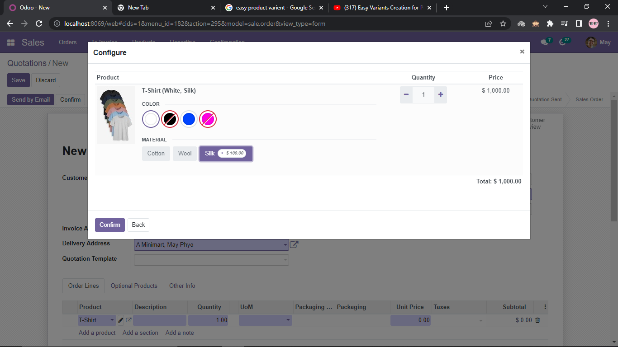
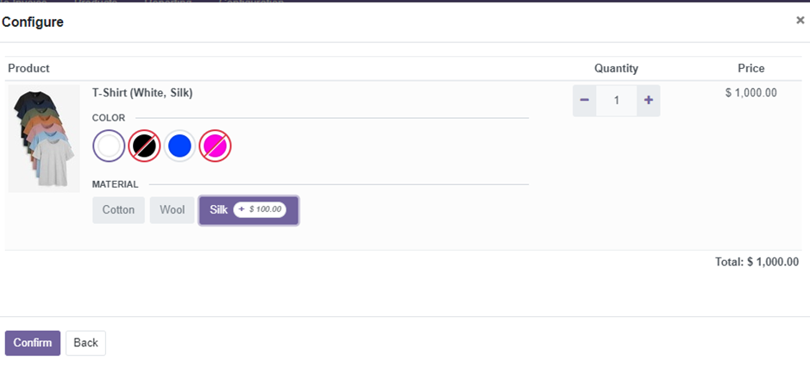
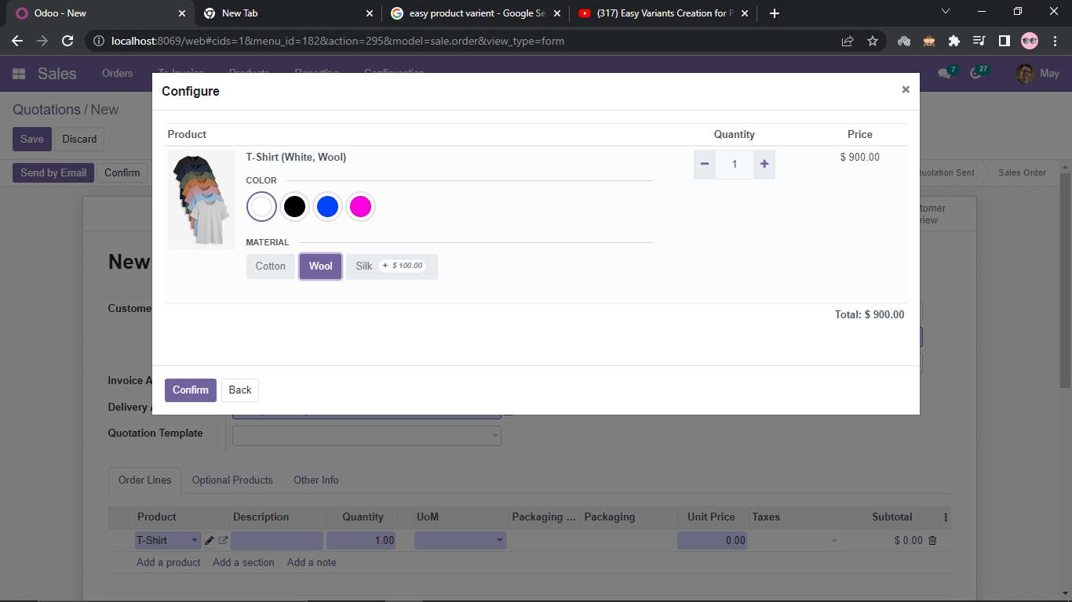
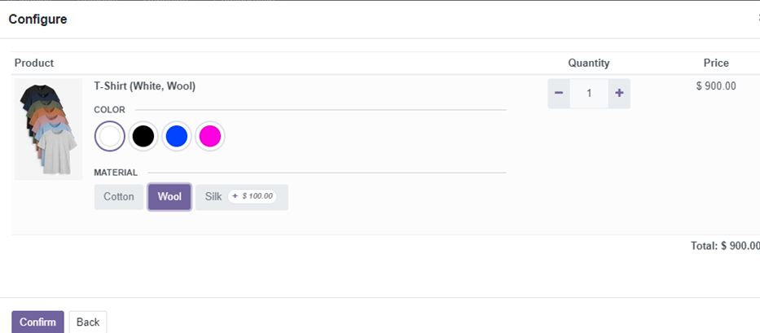
In Sales Order, this product will show that defined value for each attribute.

Slide 26
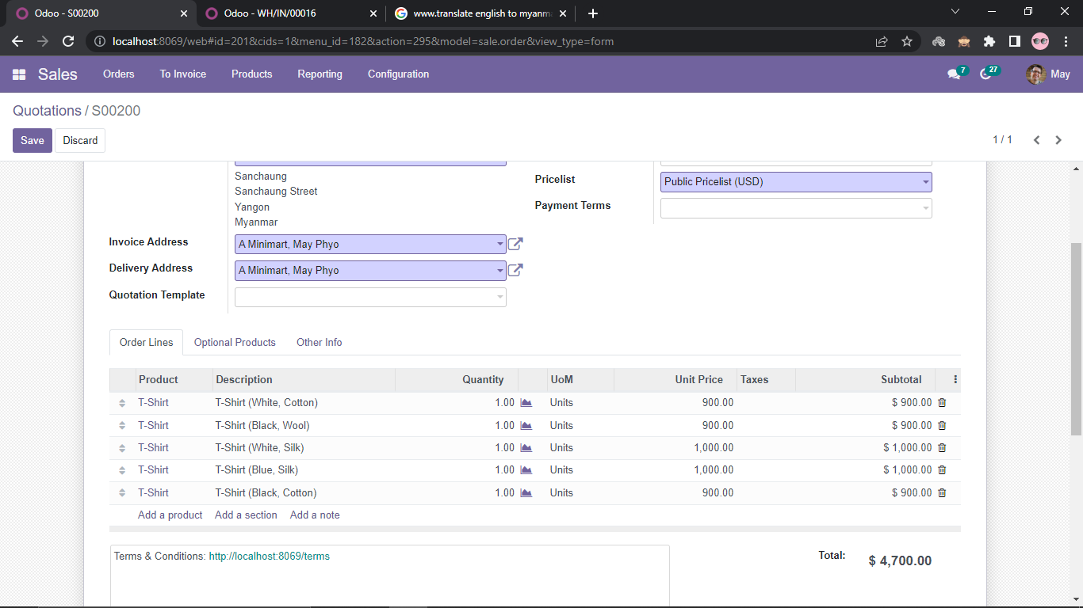
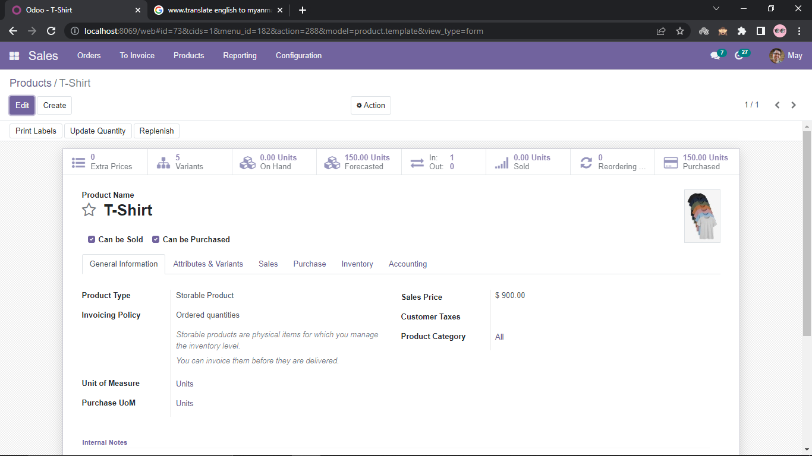
In order line, each T-Shirt with its variants are added.

Slide 27
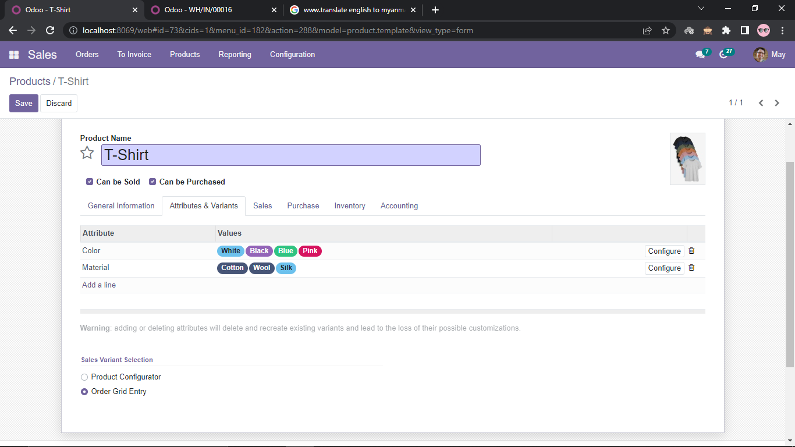
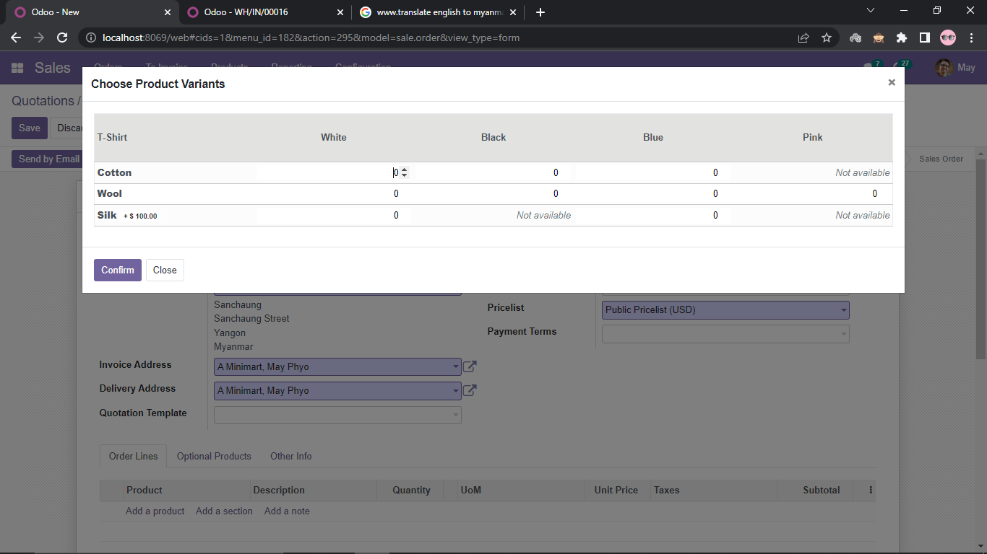
Select Order Grid Entry in product’s attributes & variants.
In sales order, this product will show some variants are not available.

Slide 28
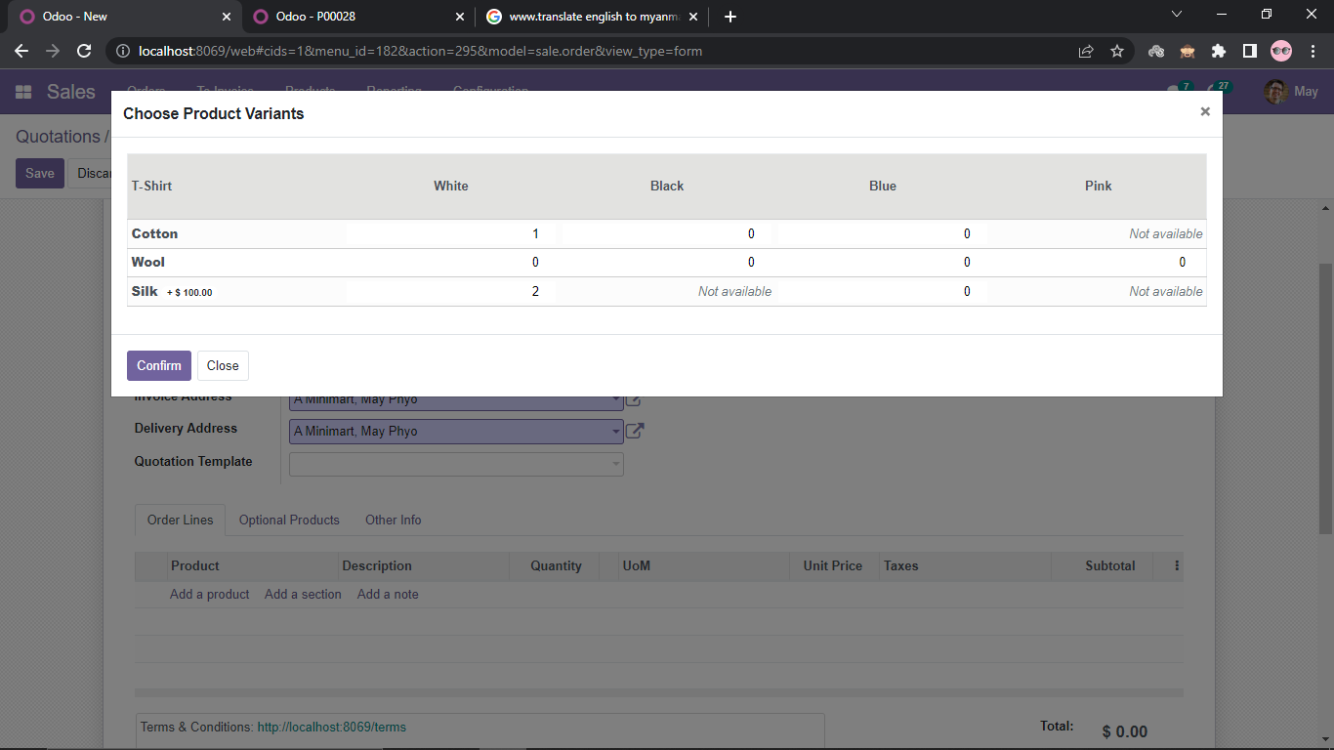
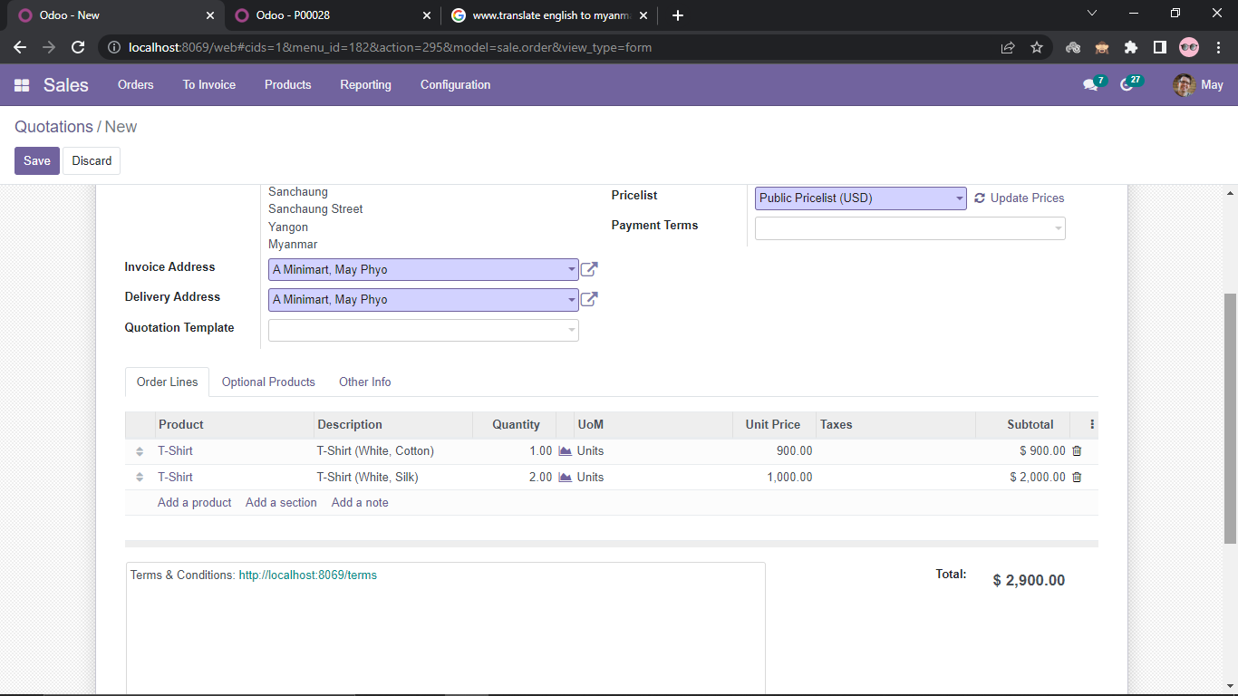
This product with two variants are added in sales order.

Slide 29
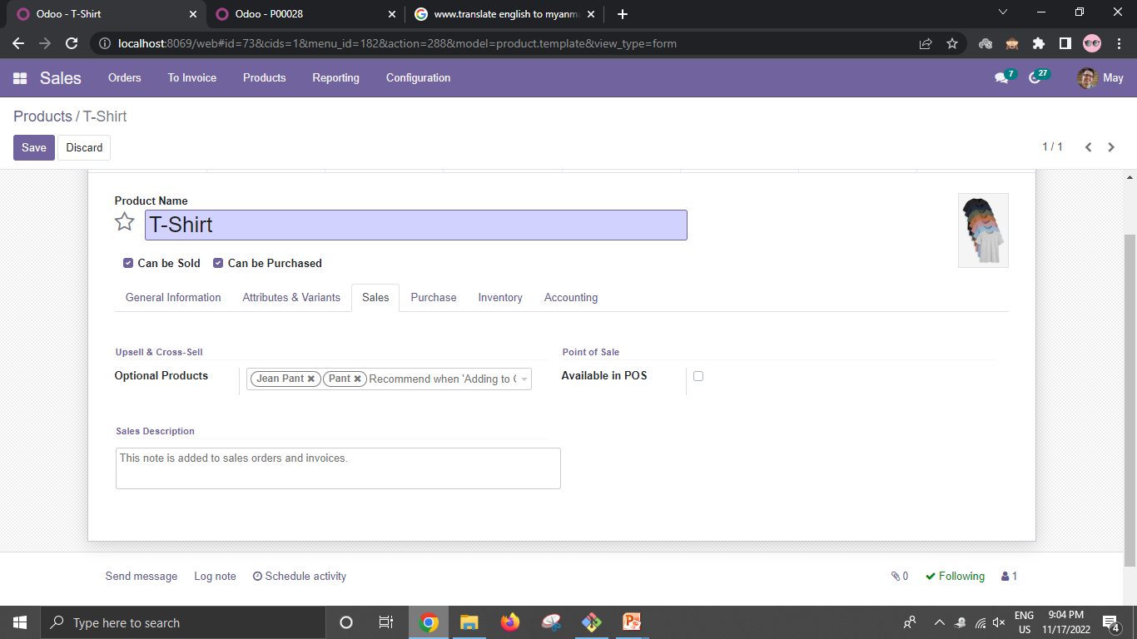

Optional Products are added in this product(T-Shirt).

Slide 30



Slide 31


Packaging
Configuration => Settings =>Product Packagings
Product => Inventory

Slide 32


In sales order for this product that defined “packaging” in Product Create step

Slide 33



Sales Team
Configuration => Settings =>Sales Team

Slide 34




Create Quotation

Slide 35



Create Quotation Template

Slide 36


Create Quotation with Quotation Template

Slide 37

Depending on our business, we may send the quotation to the customer for review, either in PDF format or online, before it becomes a confirmed Sales Order,
Or, we may immediately confirm Quotations into Sales Order.
The products in Sales Order are physical products to be delivered.

Slide 38
Invoicing Policy
Invoice what is ordered (Ordered Quantities)
Invoice what is delivered (Delivered Quantities)
Invoicing Policy
Invoice
Ordered
Quantities
Sales
Deliver
Deliver
Delivered
Quantities
Sales
Invoice

Slide 39

Invoice based on Ordered Quantities
The product is ready to be invoiced so the quantity is shown in bold blue.
The Create Invoice button is solid. This indicates the entire order is set to “Ordered Quantity” for the invoicing policy.

Slide 40

By clicking Create Invoice,

Slide 41


By clicking Register Payment,
After invoicing, the product can be delivered.

Slide 42

Invoice based on Delivered Quantities
The product is not yet ready to be invoiced so the quantity is shown in black.
The Create Invoice button is white background. This indicates there are no invoiceable lines, and as a result of the only product being set to “Delivered Quantity” for the invoicing policy.

Slide 43

By clicking Delivery smart button, the product is ready to be delivered.
In Operations line,
By clicking Validate button, the product is delivered.

Slide 44


Once the product has been delivered, we will then have the option to Create Invoice.
In Order Lines,
In Odoo, by understanding what the colors and styles mean, we will immediately know what the next expected steps are.

Slide 45
Upselling Opportunity
When the delivered quantity comes greater than the invoiced quantity, Odoo supports the order to upsell.
“Order to Upsell” comes under the invoicing policy of the “Ordered Quantity”.
Demand [2 products]
Invoice [2 products]
Sales
Demand [1 product]
Deliver [3 products]
Invoice [1 product]

Slide 46



The Invoiced quantity is 2 units.
In Delivery process, Done quantity is set as 3 units.
The Delivered quantity is 3 units.

Slide 47



Since the delivered quantity is greater than the invoiced quantity, To Invoice => Orders To Upsell.
Click the opportunity and edit the Ordered quantity as 3 units and save.
Ordered Quantity and Delivered Quantity is shown as 3 units and Invoiced Quantity as 2 units. So, the remaining 1 unit needs to be invoiced.

Slide 48


After invoicing the remaining 1 unit, this order will have two invoices, one for 2 units and another for the remaining 1 unit.
And also quantity for ordered, delivered and invoiced changed to 3 units.

Slide 49
Back Order
When the delivered quantity is less than the initial demand, Odoo will ask the permission to create the back order.
“Back Order” comes under the invoicing policy of the “Delivered Quantity”.
Demand [3 products]
Deliver [2 products]
Sales
Back Order [1 product]
Invoice [2 products]
Deliver [1 product]
Invoice [1 product]

Slide 50


The ordered quantity is 3 units.
In Delivery process, the Done quantity is set as 2 units.

Slide 51



By validating, Odoo will ask to create a back order of the delivery order.
The Delivered quantity is 2 units.
The delivered products is to be invoiced.

Slide 52




Because a back order for the delivery order is created, this sales order will have two deliveries, one for remaining 1 unit (waiting) and another for 2 units (delivered).
If the product is available, the Reserved quantity is shown as Available.
After delivering, the remaining products are to be invoiced.

Slide 53


Discounts and Margins
A discount is an acceptable amount that can be deducted from a product price and the margin is the profit that a company earns from a sale.
In Quotation state, the buyers often ask for a lower price.
In this situations, by looking at the Margins, the sellers must adjust the discounts.
Configuration => Settings and check Discounts and Margins and then save.

Slide 54

The ordered quantity is 3 units and the unit price is $60 and the discount is 5%. So, the subtotal is $171 (Quantity * Unit Price)* 5%.
The profit (margin) is $21 (Total Sales Price – Total Cost)
Total Sales Price is $171 and Total Cost is $150 (Quantity * Cost).

Slide 55


Product Pricelists
Pricelists are a way to provide different prices on individual products.
For Multiple prices per product,
Configuration => Settings and check Pricelists and select Multiple prices per product and then save.
After the configuration settings for pricelists, Pricelists will be seen under the Products menu.

Slide 56



Oppo product has 4 variants.
By creating sales order,

Slide 57


For Advanced price rules,
Configuration => Settings and check Pricelists and select Advanced price rules and then save.
Click

Slide 58



By clicking add a line, a pop up window (Create Pricelist Rules) will appear.

Slide 59


By creating sales order,
[Sales Price - (Sales Price * 7%)]
[$60 - ($60 * 7%)] + $1 = [$60 - $4.2] + 1= $55.8 (rounding 1) = $ 56.00

Slide 60


There are two discount policies.
Firstly, check Configuration => Discounts and then they will see in configuration line of pricelist creation.
Default

Slide 61


The unit price is $60 and the discounted price is $ 55 each.
For 3 units, $60 * 3 = $180 and ($60 - $55 = $5) * 3 = $15.
For Disc. %, $15 / $180 = $0.0833 (8.33%).
For Subtotal, $180 - ($180 * 0.0833 = $14.99) = $ 165.01
$180

Slide 62


Coupons & Promotions
A coupon is a ticket or document that allows the buyers to pay less money than usual for a product or to get it free.
The promotion is a marketing tool, used as a strategy to communicate between the sellers and buyers.
Configuration => Settings and check Coupons & Promotions and then save.
After the configuration settings for coupons & promotions, Coupon Programs and Promotion Programs will be seen under the Products menu.

Slide 63



In Coupons, there are two types of coupon programs: Free Product and Discount.
By clicking Edit Domain button,
Add a rule

Slide 64


There are 4 records of Oppo product.
(can be sold)

Slide 65





Coupon valid time
For Free Product coupon program,
For Discount coupon program,

Slide 66




To generate coupon codes, click Generate Coupon button.
By clicking Coupons smart button,

Slide 67


By creating sales order,

Slide 68

After using a coupon, a used coupon in sales order will show a state “Used”.

Slide 69


In Promotions, there are two types of promotion programs: Free Product and Discount.
By clicking Edit Domain buttons,
There are 4 customers who live in Myanmar.
There are 4 records of Oppo product.

Slide 70



Promotion valid time
For Free Product promotion program,
For Discount promotion program,

Slide 71


By creating sales order, Discount Apply On Specific Products

Slide 72

Only Oppo (White, 256GB) is a product included in the promotional plan.
So, Unit Price * 5% = $65 * 5%= $3.25 (minus)
For Total, ($65 - $3.25 = $61.75) + $60= $121.75

Slide 73

By creating sales order, Discount Apply On Cheapest Products
Only Oppo(White, 128GB) is a cheapest product included in the promotional plan.
So, Unit Price * 5% = $60 * 5%= $3 (minus)
For Total, ($60 - $3 = $57) + $65= $122

Slide 74

By creating sales order, Discount Apply On Order
Both are products included in the promotional plan.
So, ($65 + $60 = $125) * 5% = $6.25(minus)
For Total, $125 - $6.25 = $ 118.75

Slide 75



Delivery Methods
Firstly, create a service product for delivery charges and save.
Configuration => Settings and check Delivery Methods and then save.
Then, click Shipping Methods under Configuration menu.

Slide 76

There are two types of shipping methods: Fixed Price and Based on Rules.
For Fixed Price method,

Slide 77


By creating sales order,
Delivery Cost
Fixed Price + Fixed Price * Margin on Rate (10 + 10 * 10% = 10 + 1 = 11)

Slide 78


If a line is updated, shipping cost have to update.

Slide 79



For Based on Rules method,
Click to add rules
Created rules

Slide 80


By creating sales order,
Delivery Cost

Slide 81


Delivery Cost

Slide 82
Conclusion
ERP enables the management of organization’s resource to be used more effectively and efficiently.
Odoo software is a comprehensive ERP solution that companies can customize to meet the needs of businesses of any size.
Odoo ERP Sales Module is an integral part of the ERP system.
It helps in managing the sales and marketing activities effectively.

Slide 83

For Your Attention

